Slide 1
Assignment 3 Defusing Bomb
Jinwon Lee
Junghyun Kim

Slide 2
Contents
Defusing Bomb
Tools
objdump
gdb

Slide 3
Defusing Bomb
Binary Bomb
Consists of sequence of phases
Each phase need a particular string
If all phases are solved, bomb will be defused
Find correct string and write it in solution.txt
Upload the solution.txt in gitlab
Each student has own bomb

Slide 4
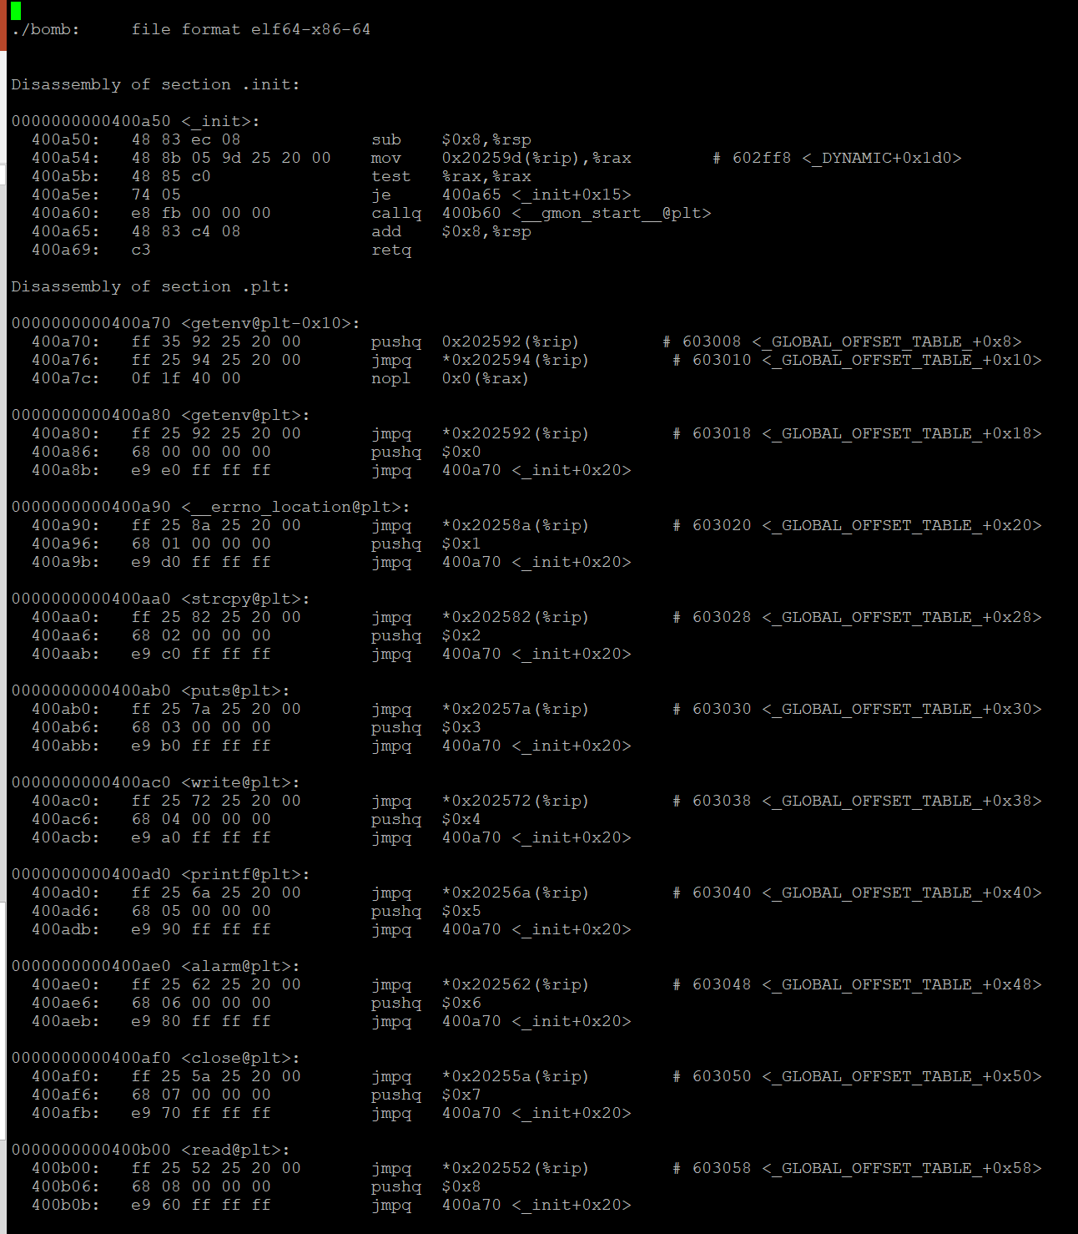
Tools - objdump
Use for disassembling binary file
objdump –d ./b_file
If you want to write the assembled code into certain file, you can use ‘>’ command
objdump –d ./b_file > file.txt

Slide 5
Tools - gdb
Use for tracing program line by line
Set breakpoint in certain function
Investigate some registers, memory and etc.

Slide 6
Q & A

